Slide 1


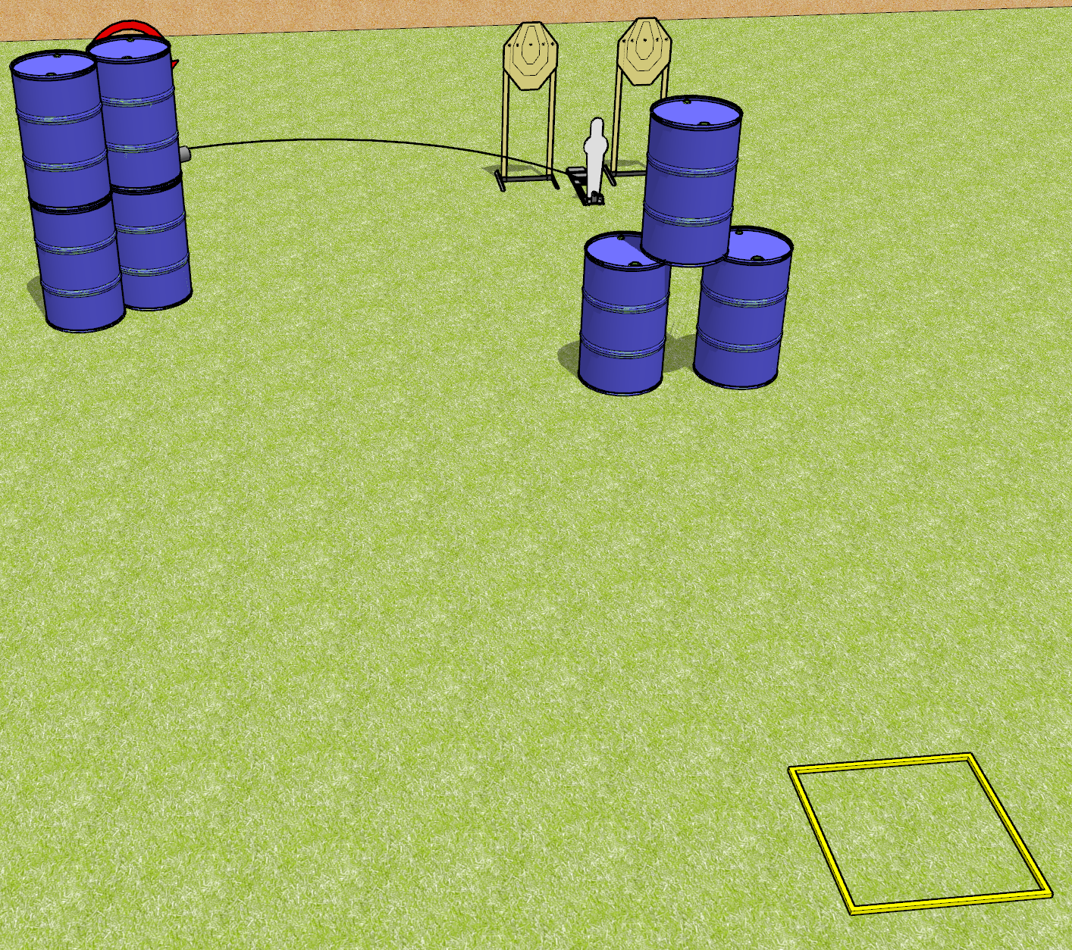
 | Dothan Gun Club – USPSA Match Down in Back Course Designer : Drew Coleman
Round Count 11 rounds 3 IPSC 1 Mini popper
Equipment List 1 swinger + activator

Slide 2
Down in Back
Written Stage Briefing
Down in Back is an 11 round, 55 point, Comstock speed shoot. There are 3 IPSC targets and 1 steel . The best 2 hits on the static paper will score, and best 6 hits on the swinger will score. Steel must fall to score.
The swinger is activated by the mini popper and is visible at rest. Please check the activator prior to walkthrough and set it the same way every time.
Handgun start position is in shooting box, wrists above shoulders. Handgun is loaded and holstered.
PCC start position is in shooting box, stock on belt. Loaded carbine is held with both hands, safety on.
The static paper and the mini popper are one array. The static paper require 2 hits each.
The swinger is another array, and requires 6 hits.
On start signal, engage 1 array, perform a mandatory reload, and engage the remaining array. You must perform a reload when changing between arrays.

